Slide 1
Lesson 9
Visualization 2
Kush Kulshrestha

Slide 2
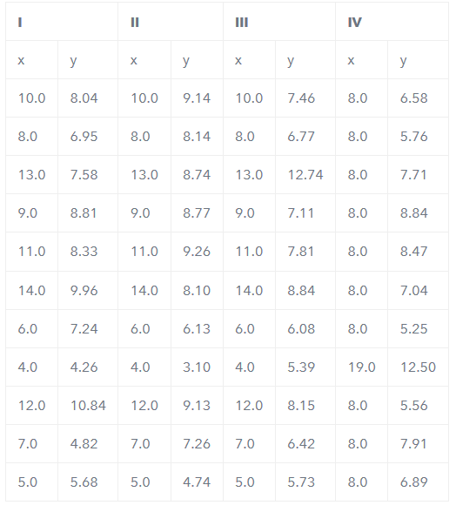
Why do we even need Viz?
There could be datasets that appear to be similar when using typical summary statistics, yet tell different stories when graphed.
Example, each dataset consists of eleven (x,y) pairs as follows:

Slide 3
Why do we even need Viz?
Observations:
The average x value is 9 for each dataset.
The average y value is 7.50 for each dataset
The variance for x is 11 and the variance for y is 4.12
The correlation between x and y is 0.816 for each dataset
So far these four datasets appear to be pretty similar. But when we plot these four data sets on an x/y coordinate plane, we get the following results:

Slide 4
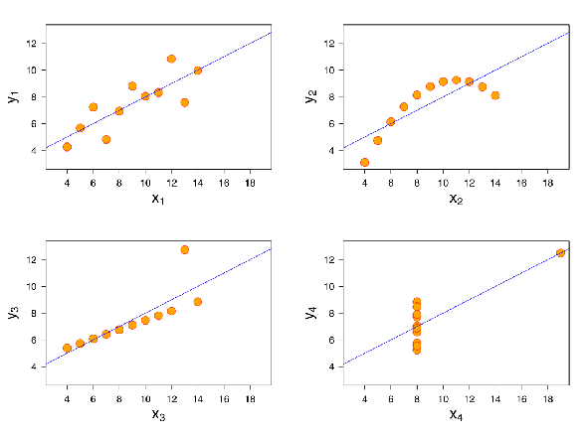
Why do we even need Viz?
Now we see the real relationships in the datasets start to emerge

Slide 5
Why do we even need Viz?
Dataset I consists of a set of points that appear to follow a rough linear relationship with some variance.
Dataset II fits a neat curve but doesn’t follow a linear relationship (maybe it’s quadratic?).
Dataset III looks like a tight linear relationship between x and y, except for one large outlier.
Dataset IV looks like x remains constant, except for one outlier as well.
Computing summary statistics or staring at the data wouldn’t have told us any of these stories. Instead, it’s important to visualize the data to get a clear picture of what’s going on.

Slide 6
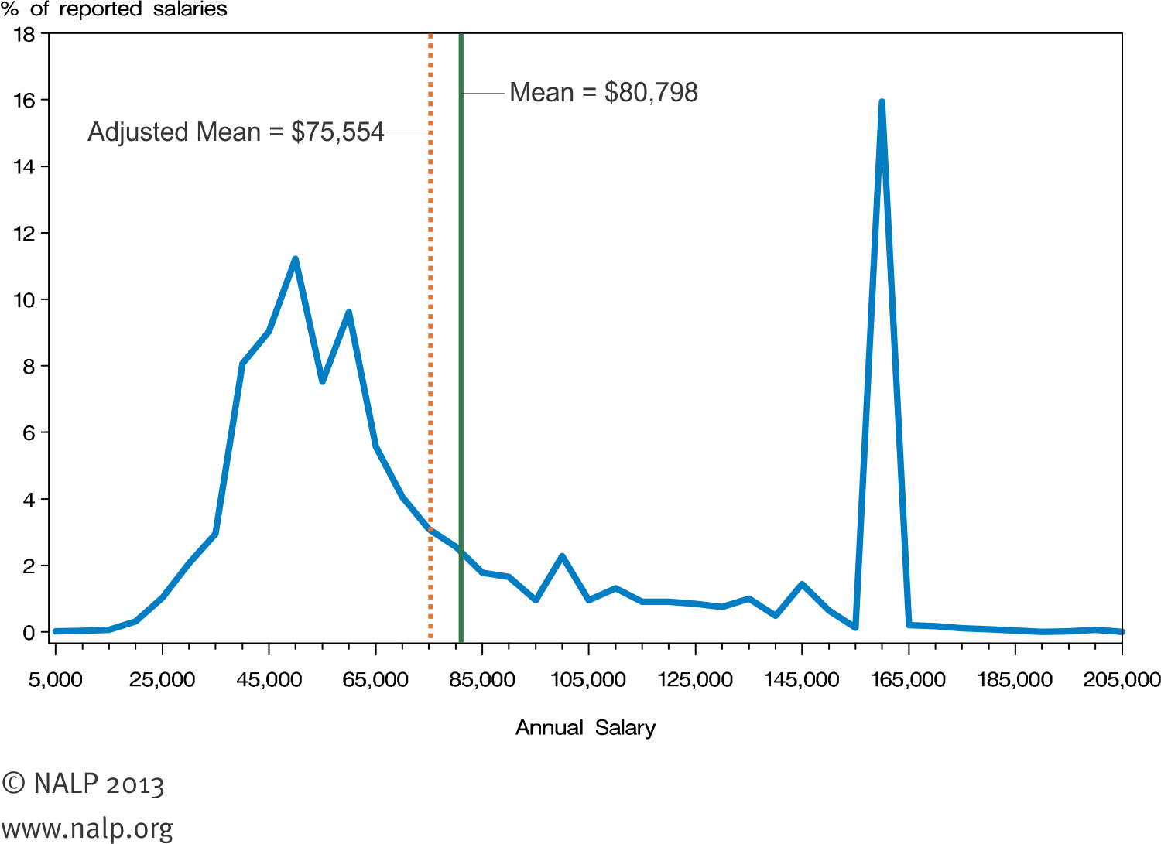
Why do we even need Viz? One more Example

Slide 7
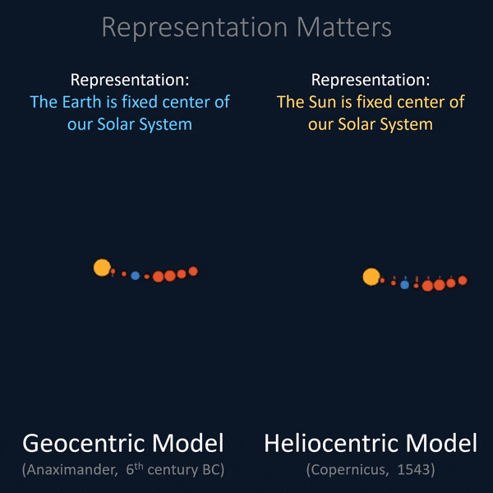
Representation Matters

Slide 8
Cognitive Load and Clutter
Cognitive Load is the amount of mental effort required to interpret information.
Cognitive Load
Intrinsic
Extraneous
Germane

Slide 9
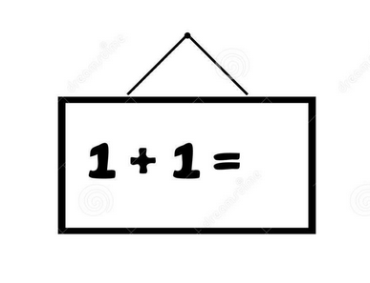
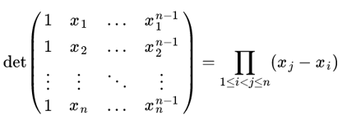
Cognitive Load and Clutter
Intrinsic Cognitive Load
Amount of memory we need to understand an idea.
Adding 2+2 is easier, doing difficult math division is difficult. If we don’t concentrate in the latter, we end up spending more time.

Slide 10
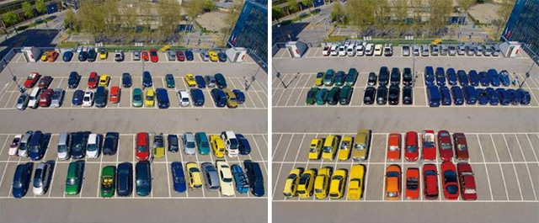
Cognitive Load and Clutter
Extraneous Cognitive Load
It relates to how information is presented.
It is the amount of extra brain power you need to understand a poorly designed Viz.
Poor design requires more effort to identify problems and create a mental image.
This is because of how information is presented.

Slide 11

Cognitive Load and Clutter
Germane Cognitive Load
It is a way for the brain to look for the patterns to develop context.

Slide 12

Cognitive Load and Clutter
Clutter is all the things you remove while still preserving key ideas.
Reduce clutter to minimize user’s cognitive load
Less clutter = More effective Visualization

Slide 13
Cognitive Load and Clutter

Slide 14
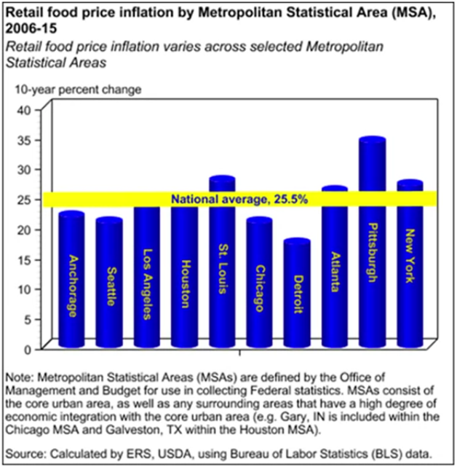
Cognitive Load and Clutter
Report of USDA’s (US Department of Agriculture) Economic Research Department
This is a regular report put out regularly by renowned statisticians.

Slide 15
Cognitive Load and Clutter
Things to be removed:
3 D effect
Overuse of bright colors. They are drawing attention to no specific place.
Yellow ticker as a threshold!
No sorting of the data?
What is x-axis for? Unhelpful axis

Slide 16
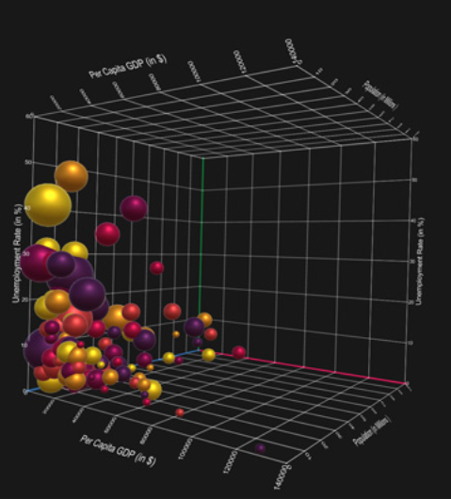
Cognitive Load and Clutter
Why not to use 3-D?
3-D doesn’t improve a Visualization
Skews information (remember Steve Jobs?)
Adds confusion

Slide 17

Cognitive Load and Clutter
Some other tips:
Use currency sign with the number
Always use percent sign when drawing percentages.
Commas with number, whenever number is bigger than 9999
Use consistent scientific notation if numbers are too big.

Slide 18

Gestalt Principles

Slide 19
Cognitive Load and Clutter
Gestalt refers to the patterns that you perceive when presented with a few graphical elements.

